Slide 1
Car Rental
System
STUDY #02
CASE

Slide 2
Overview
The Car Rental System project is an end-to-end implementation of a car rental management application, focusing on SQL database interactions using Python.
Objective
STUDY #02
CASE
To develop a robust and efficient car rental system that allows managing customers, cars, leases, and payments.

Slide 3



Tech stack
Python
SQL Server
PyUnit
STUDY #02
CASE

Slide 4
Overview
📂 Entity/Model: contains entity classes
📂 Dao: Data Access Object interfaces and implementations
📂 Exception: custom exceptions
📂 Util: Utility classes for database connections
📂 Main: Main application
STUDY #02
CASE

Slide 5
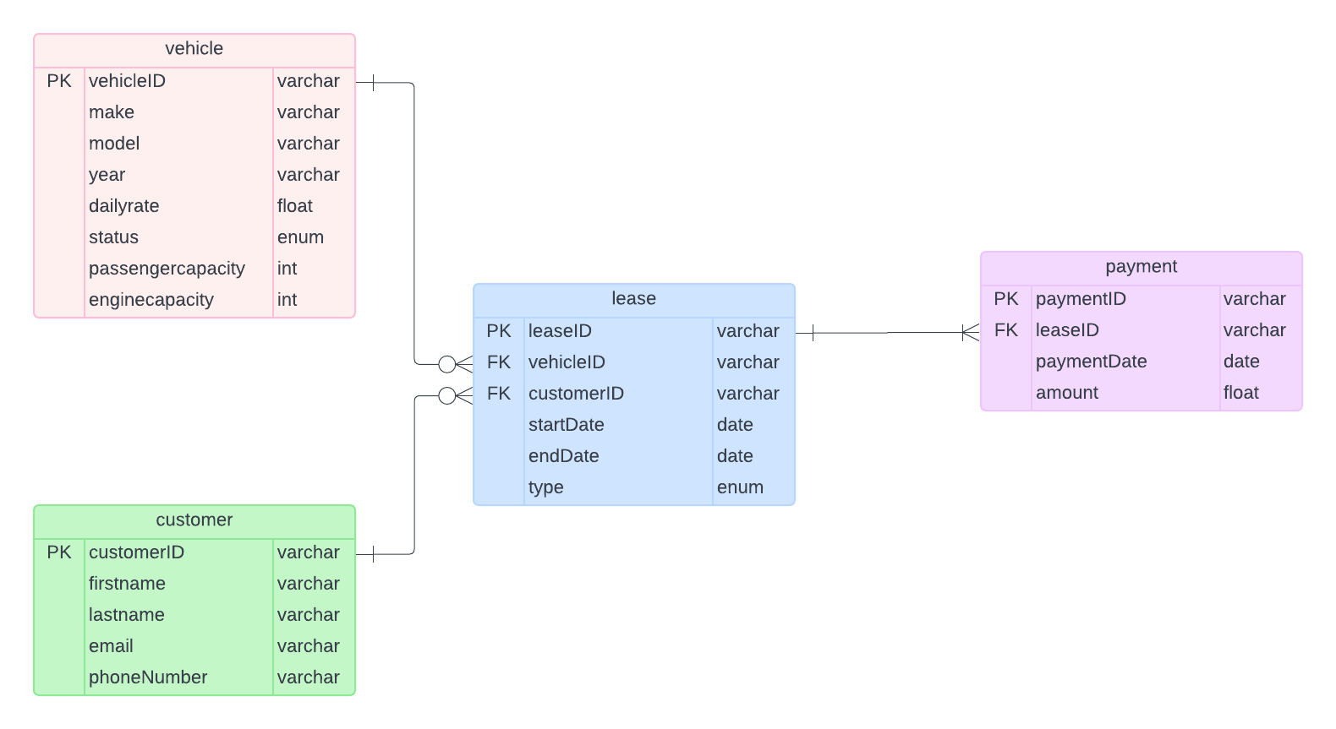
ERD for Database
STUDY #02
CASE

Slide 6



Features
Seamlessly manage customer interactions, from effortless registration and removal to comprehensive listing and individual identification, ensuring a smooth and personalized user experience.
Streamline the administration of vehicles, enabling effortless addition, removal, and meticulous tracking of car inventory, encompassing both available and rented vehicles, to optimize fleet management efficiency.
Simplify the booking process by creating and managing lease agreements between customers and cars, including meticulous tracking of active leases and thorough documentation of lease history, ensuring operational transparency and efficiency.
Simplify the booking process by creating and managing lease agreements between customers and cars, including meticulous tracking of active leases and thorough documentation of lease history, ensuring operational transparency and efficiency.

Slide 7


Features
Seamlessly manage customer interactions, from effortless registration and removal to comprehensive listing and individual identification, ensuring a smooth and personalized user experience.
Streamline the administration of vehicles, enabling effortless addition, removal, and meticulous tracking of car inventory, encompassing both available and rented vehicles, to optimize fleet management efficiency.
Simplify the booking process by creating and managing lease agreements between customers and cars, including meticulous tracking of active leases and thorough documentation of lease history, ensuring operational transparency and efficiency.
Simplify the booking process by creating and managing lease agreements between customers and cars, including meticulous tracking of active leases and thorough documentation of lease history, ensuring operational transparency and efficiency.

Slide 8


Features
Seamlessly manage customer interactions, from effortless registration and removal to comprehensive listing and individual identification, ensuring a smooth and personalized user experience.
Streamline the administration of vehicles, enabling effortless addition, removal, and meticulous tracking of car inventory, encompassing both available and rented vehicles, to optimize fleet management efficiency.
Simplify the booking process by creating and managing lease agreements between customers and cars, including meticulous tracking of active leases and thorough documentation of lease history, ensuring operational transparency and efficiency.
Simplify the booking process by creating and managing lease agreements between customers and cars, including meticulous tracking of active leases and thorough documentation of lease history, ensuring operational transparency and efficiency.

Slide 9

Features
Seamlessly manage customer interactions, from effortless registration and removal to comprehensive listing and individual identification, ensuring a smooth and personalized user experience.
Streamline the administration of vehicles, enabling effortless addition, removal, and meticulous tracking of car inventory, encompassing both available and rented vehicles, to optimize fleet management efficiency.
Simplify the booking process by creating and managing lease agreements between customers and cars, including meticulous tracking of active leases and thorough documentation of lease history, ensuring operational transparency and efficiency.
Simplify the booking process by creating and managing lease agreements between customers and cars, including meticulous tracking of active leases and thorough documentation of lease history, ensuring operational transparency and efficiency.

Slide 10




Key Functionalities
User Management
Adding new customer
Removing Existing customer
Listing all the customers
Listing Customer by ID
MANAGEMENT
USER

Slide 11
Key Functionalities
Vehicle Management
Adding new vehicle
Removing Existing vehicle
Listing available vehicle
Listing Rented vehicle
Finding Vehicle by ID
MANAGEMENT
VEHICLE

Slide 12
Key Functionalities
Lease Management
Creating new lease
Ending Lease
Listing all active leases
Listing all lease history
MANAGEMENT
LEASE

Slide 13
Key Functionalities
Payment Management
Recording Payments
MANAGEMENT
PAYMENT

Slide 14
Unit Testing
Test Cases :
Test car creation.
Test lease creation.
Test lease retrieval.
Test exceptions for invalid IDs.
STUDY #02
CASE

Slide 15
Thank You

